Slide 1

Aged care – a Marxian approach

Slide 2

What can this approach provide us with, that other approaches cannot?
The use value/exchange value lens
A 'long view of history' approach to see the current Australian situation in context

Slide 3
The use value/exchange value lens
A basic distinction in Marxian thinking is between the production of use values and the production of exchange values.
What sort of things do we produce for use?
What sort of things for exchange?
What did, or do, different societies do? Think of various societies across the ages, and what things they might have produced for use, and for exchange.
What is the overwhelmingly dominant tendency within capitalism?
( - and pssst!.... when does capitalism begin?)

Slide 4
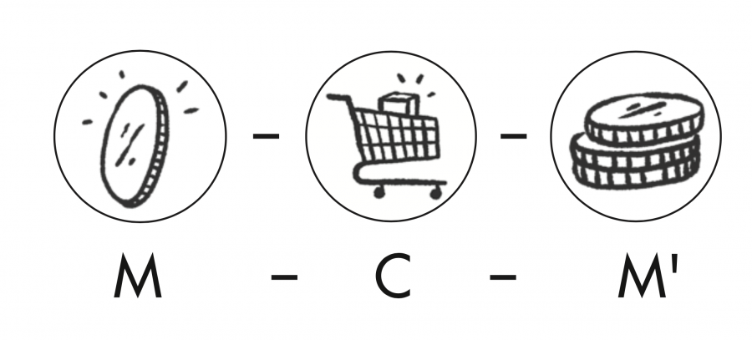
Why does this matter...??
Well, it leads to markets... which have enormous effects on human societies.... positive and negative.
Use value production
Commodity - Commodity (C - C) (barter)
Commodity – Money - Commodity (C – M - C) (money appears)

Slide 5
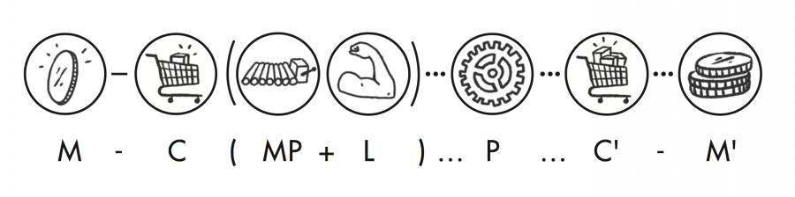
Money – Commodity – more Money (mercantile capitalism)
Money – Commodity (1. labour power and 2. means of production)– more Money (industrial capitalism) (1750 on)
Money – more Money (via interest – Finance capitalism)

Slide 6
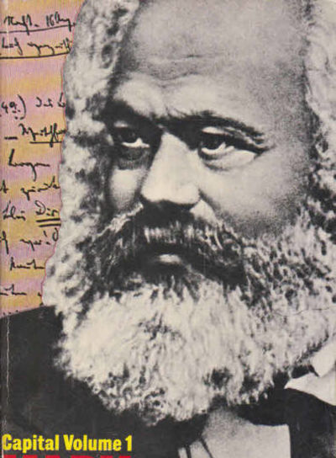
"The wealth of societies in which the capitalist mode of production prevails appears as an “immense collection of commodities; the individual commodity appears as its elementary form."
Capital Volume 1, Translation by Ben Fowkes (Marx 1867/1990, 125)
So - (nearly) everything is commodified – that is, it is produced not for use value, but for exchange value – unlike every previous society...

Slide 7
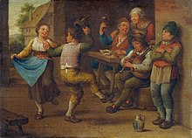
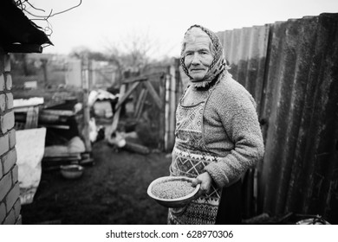
So Aged Care has become commodified. What does this mean?
In previous societies, the aged were cared for primarily in the family home. They were fed, clothed, and assisted for nothing in return – no monetary 'kickback'(reward). They often helped in the upbringing of children and advice; they were seen as a resource of historical memory and wisdom.

Slide 8
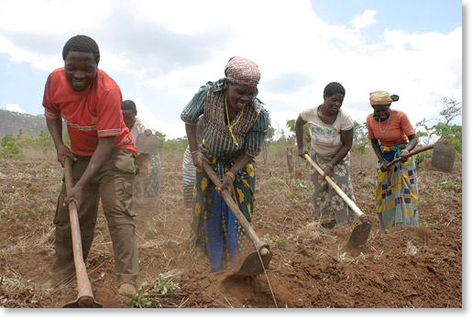
This was partly possibly because the producers (almost everybody – peasants) were not alienated from their means of production - i.e. not removed from their land.
This meant they could work at home where the older people were, and the time discipline was relatively loose. They were not governed by the clock but by natural daily and seasonal cycles, so it was easier to be flexible with time and look after the elderly throughout the day.

Slide 9
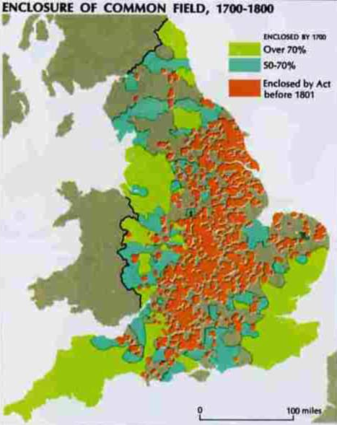
This all changes with commodification and capitalism
Peasants were removed from land to create industrial capitalism (not intentional, but was a consequence of the mercantile capitalism of wool) in the UK
They have to work at a distance from their home

Slide 10

They have to conform to (follow) the time discipline of the factory or office
The new working class have to buy their means of survival – they can't produce it. So they must work in this way.
This makes traditional care for the elderly very difficult

Slide 11
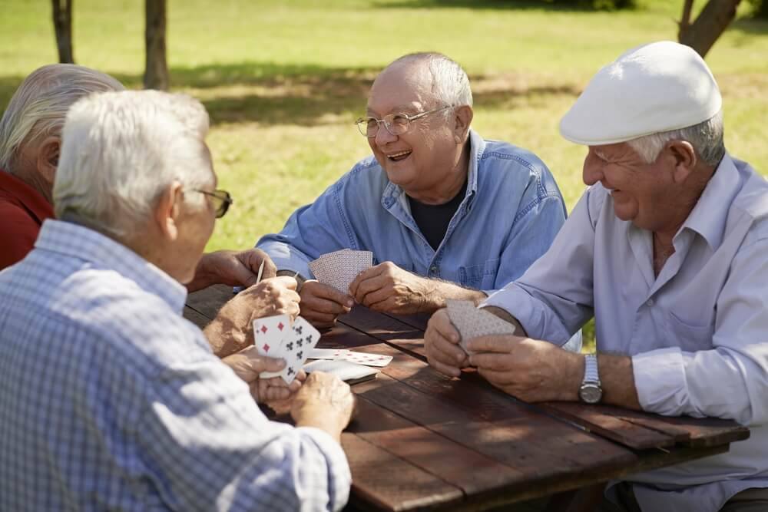
-so they have to now buy it as a commodity (in this case a service)
Other producers produce the service, and workers buy care for themselves or relatives.
These producers are 'non-profit' or profit-based.
Non-profits are often church-based; profit-based are increasingly centralising (like all capital)
Larger and larger corporations dictate the market and prices

Slide 12
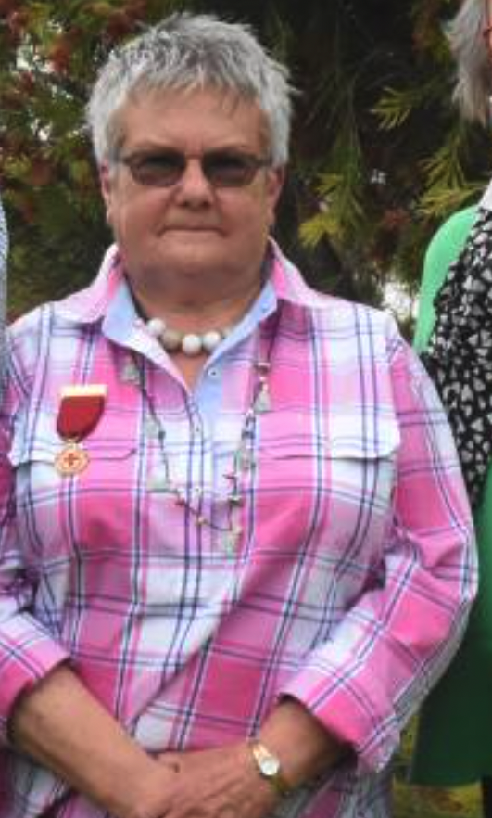
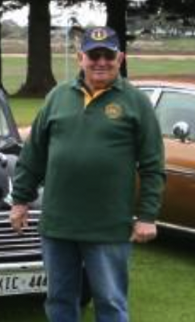
Typical case – my in-laws: Retirement home scenario
$300k for the sale of their country home
But they recently lost a 'bid' for a home
('2 ½' bedroom) in Reynella, at $396K
(we have to help them with a loan). Still not housed.
Ones closer in (Pasadena) are $620K – out of reach.
If nothing after April – will be living in their caravan.
Generally, the retirement home keeps money for the time they are in it (investing it and getting interest), and returns about 75% when they leave ( but there are many different complex business models!)

Slide 13
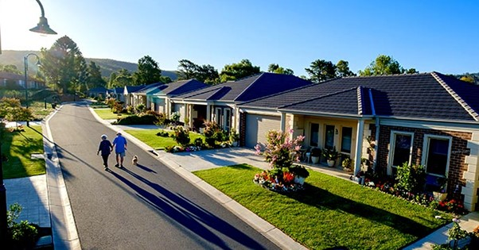
They will continue to pay an amount (about $100 /week) for maintenance etc.

Slide 14
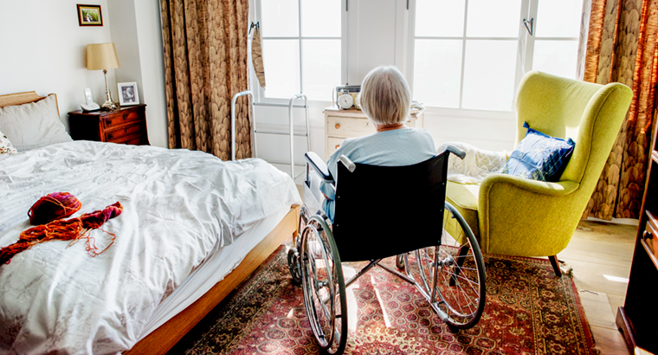
Nursing Home – the next step
Means tested:
Basic daily care fee - if assets are less than $52,000 – you are fully supported. ($56 per day = 85% of your pension will be taken to cover your care. )

Slide 15
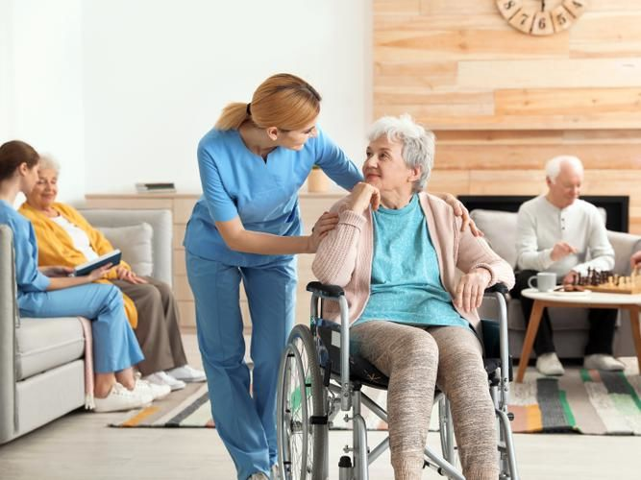
Additional rate: If you have more assets, you can pay up to $350 per day (lifetime cap of $70,000)
Refundable Accommodation Deposit (RAD) - assets less than $70k, no RAD. Greater than $178k, full cost of room (Institution takes money and invests it for the time of your stay).

Slide 16
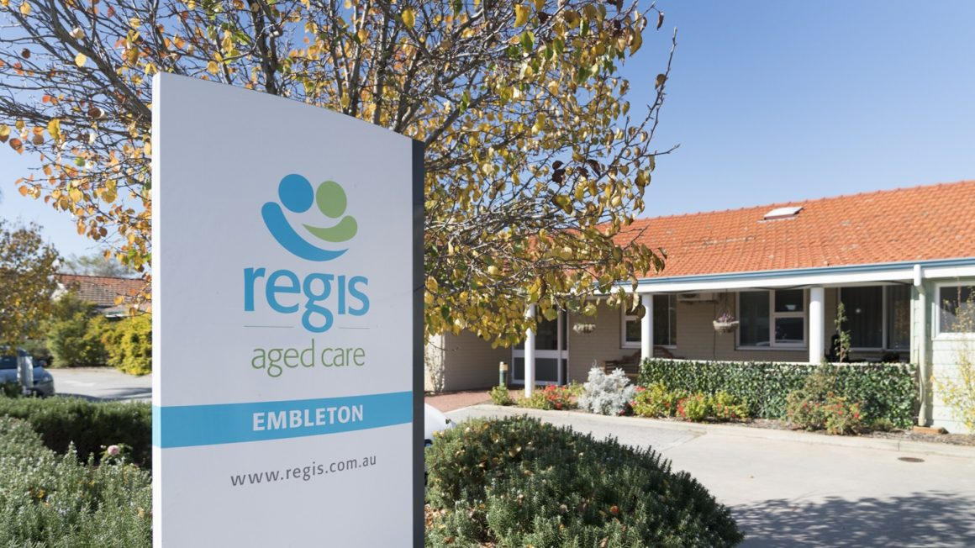
In short, the government helps fund the commodified care that private companies provide.

Slide 17
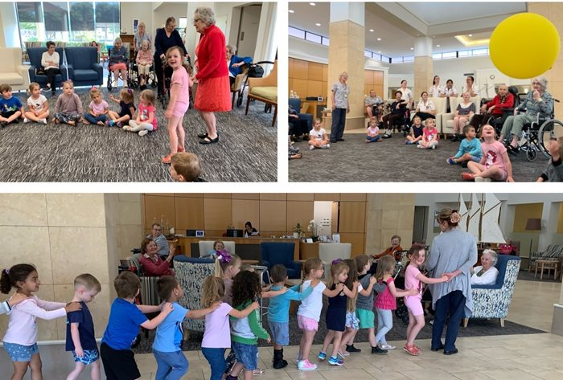
An alternate model?
Provision of service is conducted totally by the government – no profits to private companies
Building of many more public aged care centres so they are local, and not cheaply built and equipped to save on costs – no cutting of corners in terms of physical infrastructure and staff care

Slide 18
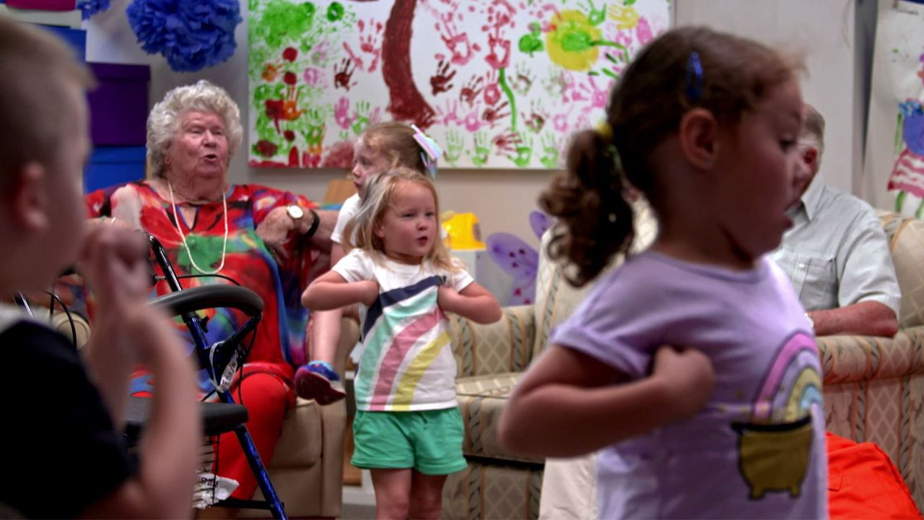
Training of aged care staff by TAFE, not private providers who 'tick and flick', producing low-quality graduates (again the consequence of commodification)
Deeper integration with schools, community groups and services so as to improve connection and enjoyment for residents – private companies often 'skimp' on this.

Slide 19
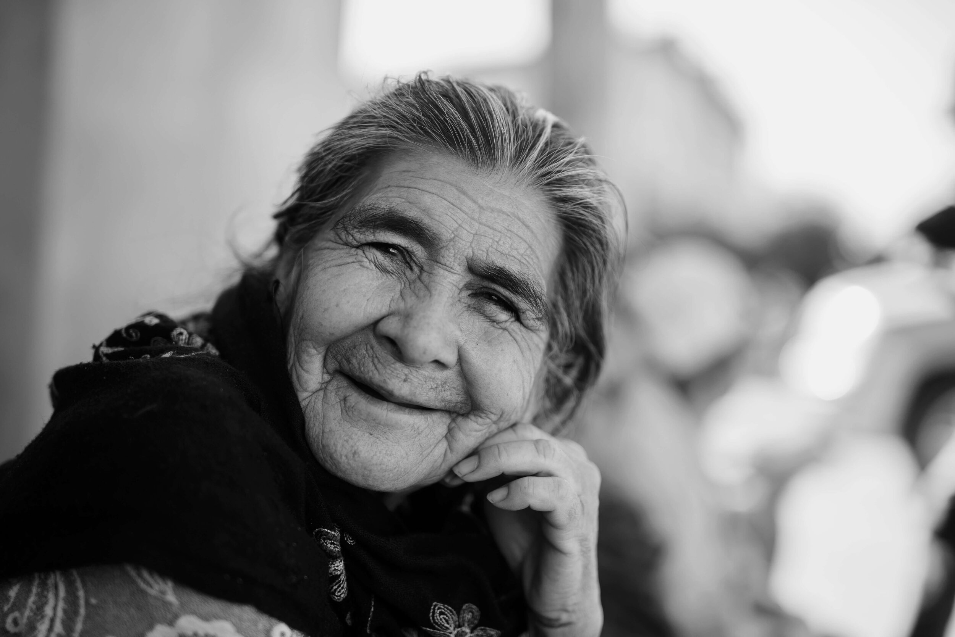
Broader cultural considerations – the historical materialist perspective
Destruction of high-context society where age is respected leads to the overall devaluation of age in low-context societies. Why?
The dominant interests/classes value 'productive' workers ( those who can produce surplus value (profits) for capitalism). Other labour is devalued – typically that of:
Domestic labour
Volunteering/community work
Relationship management and maintenance
And the labourers – typically women, the aged (past their working days), other producers of pure use-values (artists, writers, 'amateur' producers) are therefore devalued as well.

Slide 20
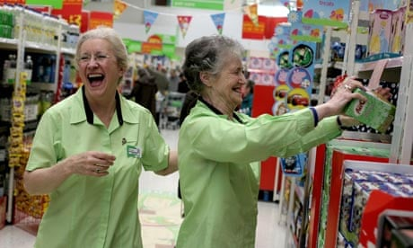
'on the scrap-heap'
Solution?
If we had an economy not driven by profit, then, over time, non-profitable work (‘unproductive’ (Marx)) would become valued. Caring labour, older labour, and volunteer labour would steadily become seen for what it is: as central and essential to the ‘social fabric’.

Slide 21
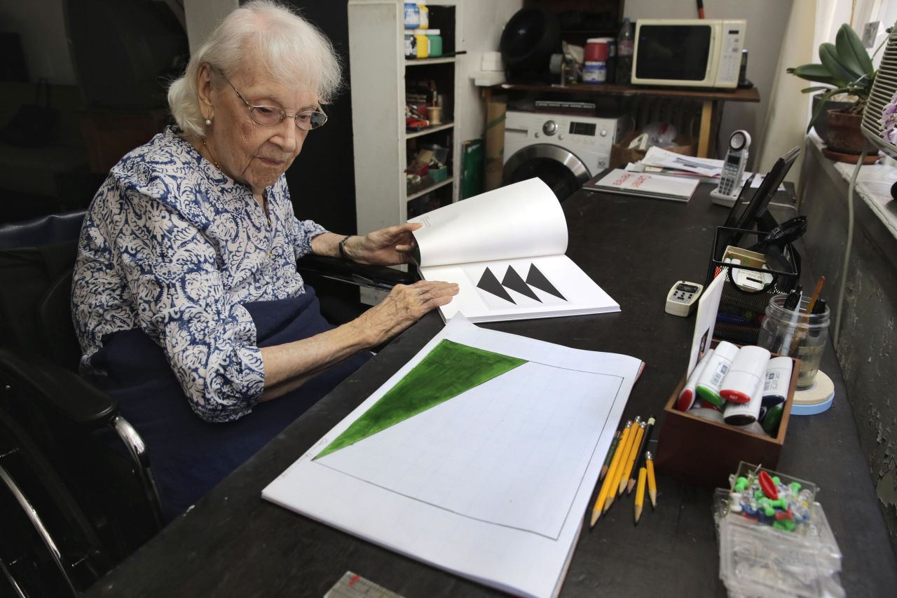
With more local, community-driven production (including for the care of older people), older people would return as pivotal figures in society, valued for their knowledge and experience.
Retirement – the sudden stopping of ‘work’ – would become a thing of the past as older people would then continue to actively contribute to important social objectives. The boundaries between ‘work’ and ‘leisure’ would become blurred for ALL.

Slide 22
- but all this requires that we see the material roots of this historical, economic, psychological, and cultural phenomenon... And this requires....

Slide 23
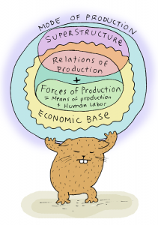
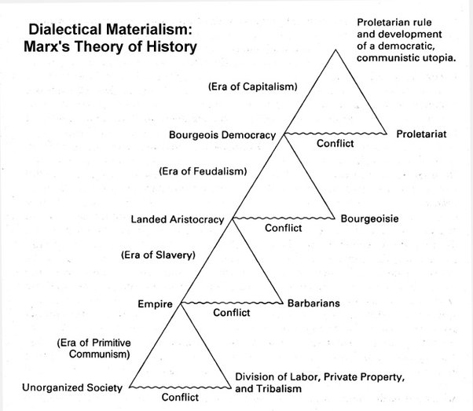
Historical Materialism!

Slide 24
- In this case using its concepts of
1. Use value/exchange value and
2. A long, historical, material view of societies to ‘throw new light’ on aged care.
... but there are many more such tools where they came from......
I encourage you to explore them further......

Slide 25



Slide 26

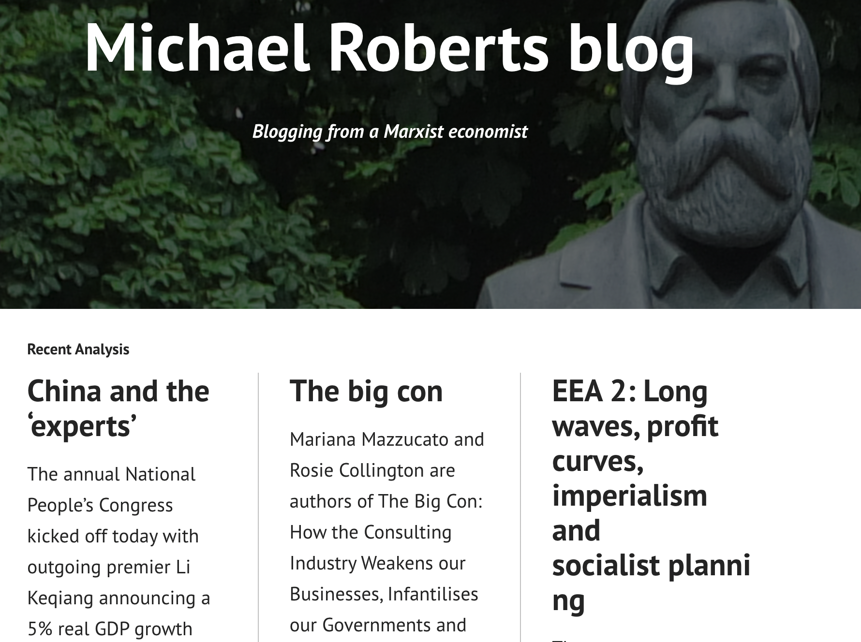

Slide 27
Aged care - a Marxian approach
Thank you for your attention!!

