Slide 1
How has the Coronavirus pandemic affected the world today?
Name: Mickey Mouse
ID: 001001001
Course: Diploma of English Proficiency
Unit: Use highly complex grammar for accuracy in communication
Lecturer: Teresa Howie
Date : xx/xx/2021

Slide 2
Contents
Acknowledgement of Country
How COVID 19 has impacted on our world
Lifestyle changes
Changes to the world economy
Social problems
Reflection on my grammar usage
Plans to improve my grammar
Feedback and questions

Slide 3
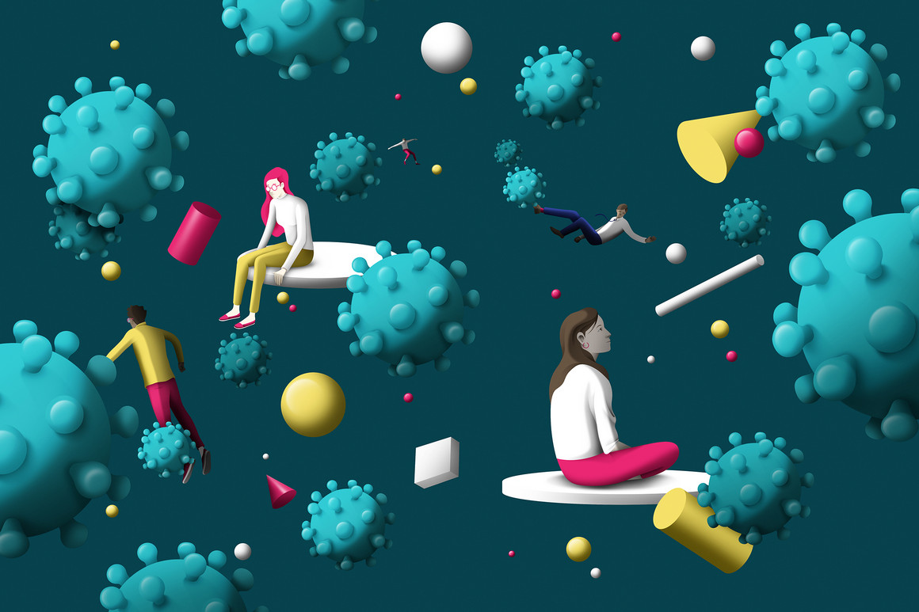
Our lifestyle has changed due to the pandemic
More than 166 million Covid-19 cases globally
More than 3.45 million Covid-19 related deaths
Social distancing, remote work and visitor order to limit gatherings
image source: xxxxx

Slide 4
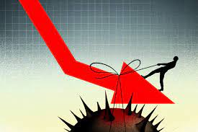
The pandemic has changed the world economy
Global shares have fluctuated significantly.
Many people have lost their jobs and unemployment rates have increased.
The travel, hospitality and tourism industries have been severely damaged.
image source: xxxxx

Slide 5
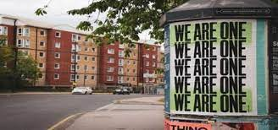
Covid-19 has created many social problems
Racism and physical attacks
Mental health
Remote learning for disadvantaged students
image source: xxxxx

Slide 6

Reflection on my own grammar use
some uncertainty about use of articles
academic writing (inc nominalisation and passive)
image source: https://www.thoughtco.com/word-class-grammar-1692608

Slide 7

My plan to improve my grammar use
build up an information resource on article use
practise writing using online support sites
do online grammar exercises regularly
image source: https://www.movus.com.au/2021/03/15/5-ways-to-improve-your-maintenance-planning-and-scheduling/

Slide 8
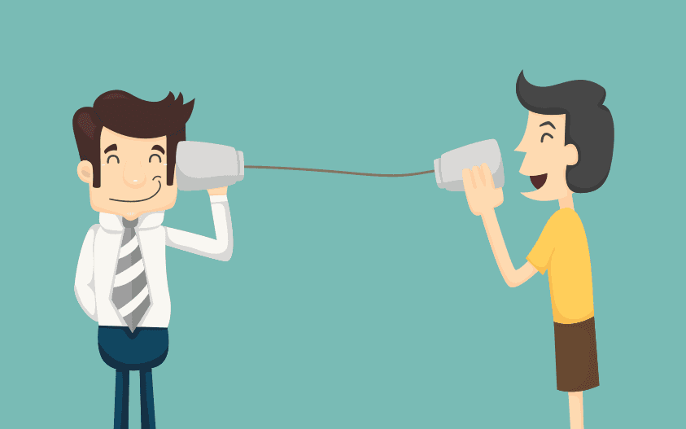
Feedback and Questions
Thank you for listening.
constructive feedback?
questions?
image source: https://www.impactplus.com/blog/5-tips-for-giving-better-feeback-to-your-sales-team/

Slide 9
References
KFF 2021, The Implications of COVID-19 for Mental Health and Substance Use, viewed 28 May 2021, https://www.kff.org/coronavirus-covid-19/issue-brief/the-implications-of-covid-19-for-mental-health-and-substance-use.
Lora, J, Daniele, P & David, B 2021, 'Coronavirus: How the pandemic has changed the world economy', BBC News, 24 Jan, viewed 28 May 2021, https://www.bbc.com/news/business-51706225.
Maria, C, 2021, 'Global impact of the COVID-19 pandemic: 1 year on', Medical News Today,12 March, viewed 27 May 2021,https://www.medicalnewstoday.com/articles/global-impact-of-the-covid-19-pandemic-1-year-on.
Miller, RC 2015, ‘5 Tips For Giving Better Feedback to Your Sales Team’, viewed 24 August 2021, https://www.impactplus.com/blog/5-tips-for-giving-better-feeback-to-your-sales-team.
Movus, 2021, 5 ways to improve your maintenance planning and scheduling, viewed 24 August 2021, https://www.movus.com.au/2021/03/15/5-ways-to-improve-your-maintenance-planning-and-scheduling/.
Thought Co, (n.d.), ‘Word class in English grammar’, viewed 24 August 2021, https://www.thoughtco.com/word-class-grammar-1692608.
WikiHow & Faulkner, G 2021, ‘How to improve your grammar’, viewed 24 August 2021, https://www.wikihow.com/Improve-Your-Grammar.

