Slide 1
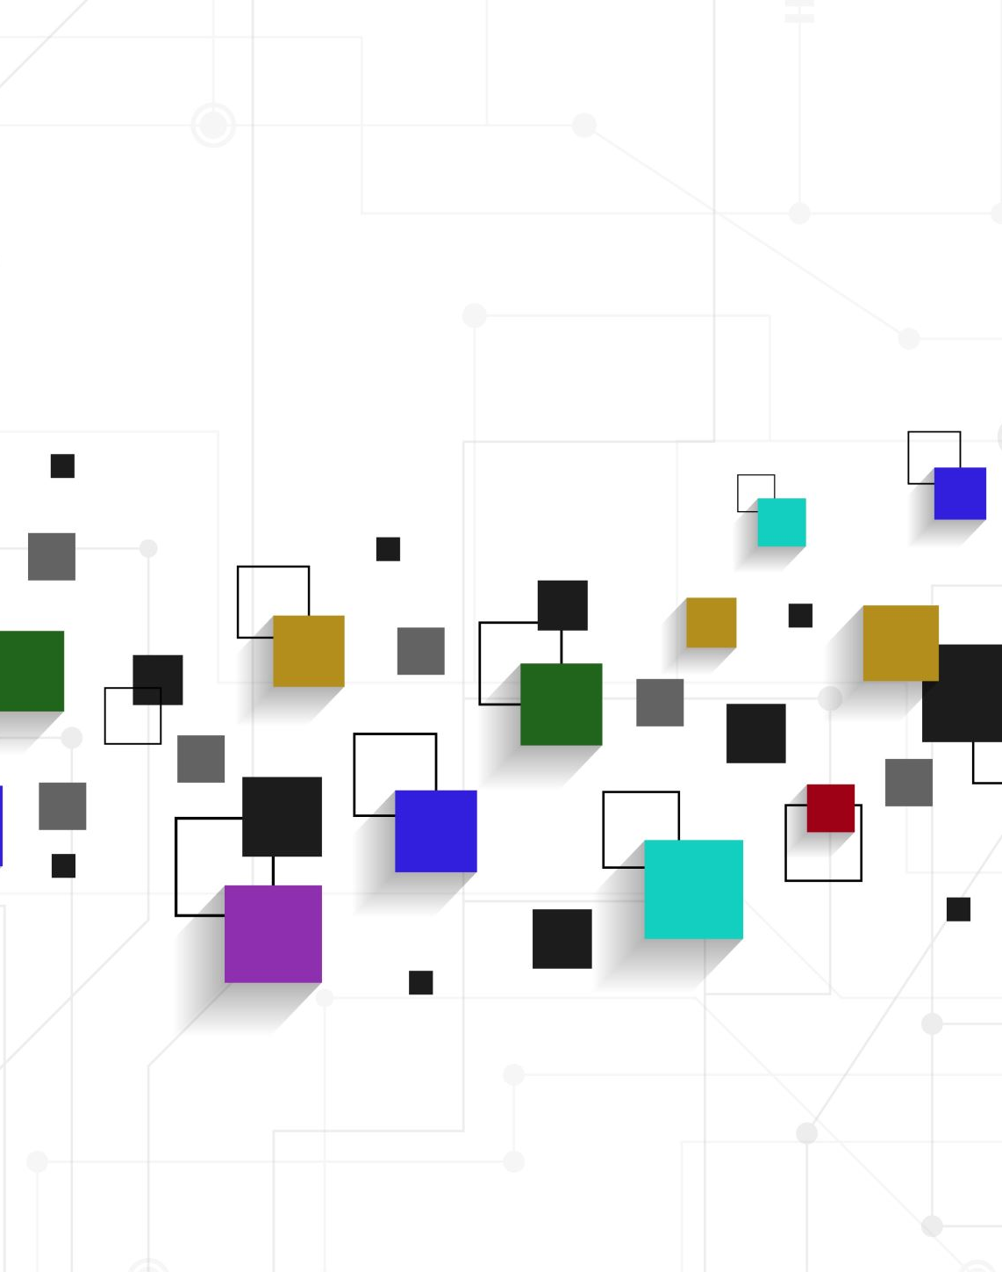
Appraisal
ATTITUDE -
Appreciation

Slide 2
Appraisal theory
allows us to understand more complex ways in which we express our personal views and react to the views of others (White, 2013)
has three resources in language: attitude, graduation and engagement
gives us the language to consider and answer questions about the intention of the writer/speaker

Slide 3
Appreciation
appreciation appraises things, situations and phenomena (not people’s behaviour)
this evaluation is also based on social norms (as for Judgement)
appreciation resources evaluate
how a thing catches our attention
how balanced or complex a thing is
how worthwhile a thing is
White 2013, HK Polyu, nd

Slide 4
Appreciation
appreciation resources can be used to highlight the writer’s/speaker’s appreciation of:
a person’s characteristics
things of worth and beauty associated with that person
a person’s physical appearance, abilities, relationships with others and the world around them
appreciation can be positive or negative
McGuire, 2008

Slide 5
Appreciation
appreciation resources can also be used in academic writing to:
emphasise the importance of the research topic
evaluate the usefulness of the supporting literature and research findings
criticise the limitations of previous research
HK Polyu, nd

Slide 6
Appreciation in academic writing
Examples:
I will consider the merits of using scripted and unscripted speaking tasks.
Item: merits
Appraised: scripted and unscripted tasks
positive appreciation
Teaching Hong Kong students to speak English is an educational conundrum.
Item: conundrum
Appraised: teaching Hong Kong students to speak English
negative appreciation
HK Polyu, nd

Slide 7
References
Hong Kong Polytechnic University, nd, ‘Attitude’, viewed 27/7/21, <www.engl.polyu.edu.hk/academic_writing/attitude.html>
McGuire R, 2008, ‘Grammar at the chalkface: an introduction to the grammar of Appraisal and its application in a Year 9 classroom’ mETAphor, Issue 1, 2008 pp 42-57
White PRR, 2013, ‘Systemic Functional Grammar: Appraisal’, An Introduction to Appraisal, ASLA

