Slide 1
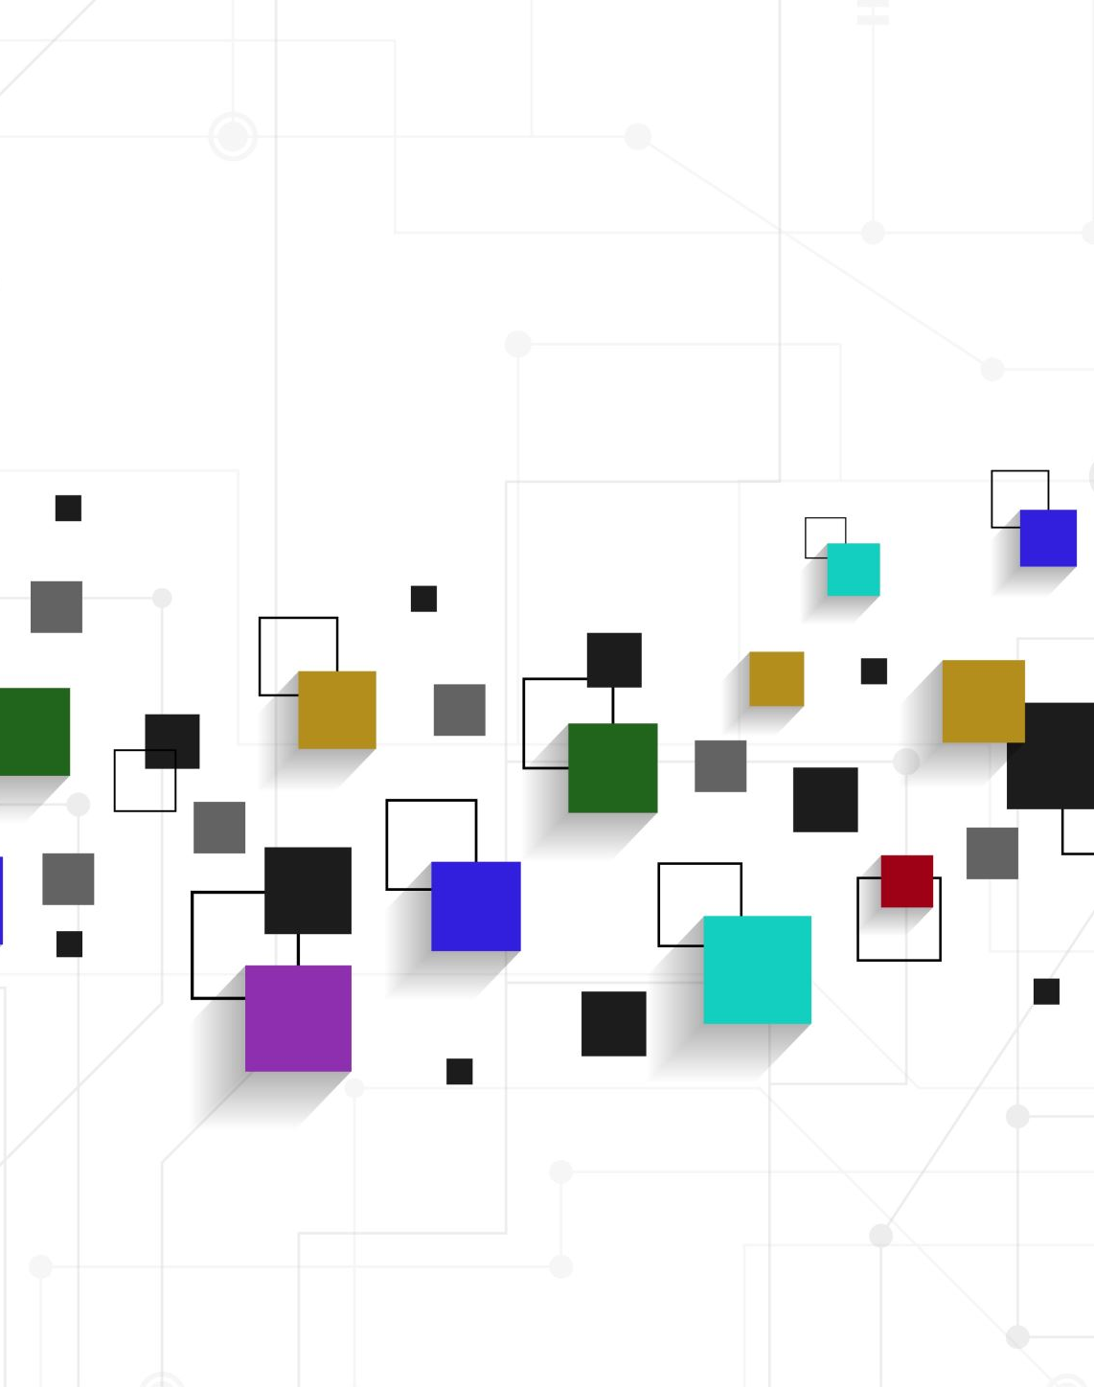
Appraisal
GRADUATION -
Force

Slide 2
Appraisal theory
allows us to understand more complex ways in which we express our personal views and react to the views of others (White, 2013)
has three resources in language: attitude, graduation and engagement
gives us the language to consider and answer questions about the intention of the writer/speaker

Slide 3
Graduation
is concerned with the ways in which speakers/writers intensify and amplify meaning
involves resources of Force to grade and amplify meaning and Focus to sharpen and soften meaning
McGuire, 2008, p 42

Slide 4
Force
can make a word or expression more intense or less intense
can be raised or lowered by choosing words with positive/negative meanings, including metaphors
can use repetition and synonymy with increasing intensity
can use intensifiers
carries the idea of more-or-less
often associated with gradable words or word with +ve/-ve alternatives

Slide 5
 | Force
intensifiers | He still plays well; he is a very powerful player.
attitudinal lexis* | The second part is fantastic.
metaphors | ice cold on a sweltering night
swearing | Dammit, there must be a clique.
*Attitudinal lexis refers to the selection of vocabulary which communicates something
of the writer’s judgements or feelings about an issue (Davison, p 536)
HK Poly, n.d.

Slide 6
Force in academic writing
Examples:
Nature and culture are highly appropriate concepts in the teaching of conversational English and are repeatedly cited by Carter himself (2001) and with McCarthy (2004) and Fung (2007).
Item: highly; repeatedly; Carter himself (2001) and with McCarthy (2004) and Fung (2007)
Graded items: appropriate; cited; in-text citation
force: intensifier

Slide 7
References
Davison, C, 2007, ‘Different Definitions of Language and Language Learning’, in Cummins J & C Davison (eds), International Handbook of English Language Teaching, Springer International Handbooks of Education 15, pp 533-548.
Hong Kong Polytechnic University, n.d., ‘Graduation’, viewed 26/10/21, <Graduation (polyu.edu.hk)>.
McGuire R, 2008, ‘Grammar at the chalkface: an introduction to the grammar of Appraisal and its application in a Year 9 classroom’ mETAphor, Issue 1, 2008, pp 42-57.
White PRR, 2013, ‘Systemic Functional Grammar: Appraisal’, An Introduction to Appraisal, ASLA.

