Slide 1

To stress or not to stress
Using emphasis

Slide 2
Objectives
Identify emphasis
Consider why we emphasize words and how we emphasize them
Practise applying emphasis

Slide 3
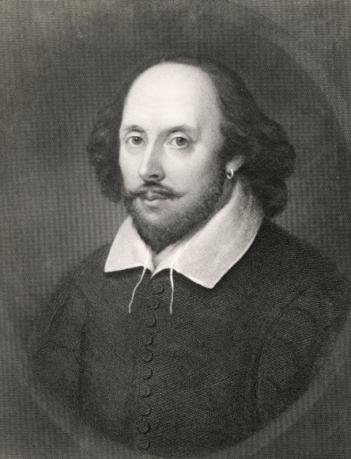
Introduction
1564–1616

Slide 4
 | actor | role | word emphasized
 | Paapa Essiedu | Shakespeare’s Hamlet | To be or not to be: that is the question.
 | Tim Minchin | Australian comedian | To be or not to be: that is the question.
 | Benedict Cumberbatch |  | To be or not to be: that is the question.
 | Harriet Walter |  | To be or not to be: that is the question.
 | David Tennant |  | To be or not to be: that is the question.
 | Rory Kinnear |  | To be or not to be: that is the question.
 | Sir Ian McKellen |  | To be or not to be: that is the question.
 | Dame Judy Dench |  | To be or not to be: that is the question.
 | Charles Windsor |  | To be or not to be: that is the question.
Sherlock Holmes
Lady Shackleton
Doctor Who
Bill Tanner
Gandalf
M (head of MI6)
the Prince of Wales

Slide 5
Activity 2 – Identifying emphasis
Watch the video and make a note of which word each speaker emphasizes most.
https://www.youtube.com/watch?v=sw_zDsAeqrI

Slide 6
 | actor | role | word emphasized
 | Paapa Essiedu | Shakespeare’s Hamlet | To be or not to be: that is the question.
 | Tim Minchin | Australian comedian
 | Benedict Cumberbatch
 | Harriet Walter
 | David Tennant
 | Rory Kinnear
 | Sir Ian McKellen
 | Dame Judy Dench
 | Charles Windsor
To be OR not to be: that is the question.
Sherlock Holmes
To be or NOT to be: that is the question.
Lady Shackleton
To be or not to BE: that is the question.
Doctor Who
To be or not to be: THAT is the question.
Bill Tanner
To be or not to be: that IS the question.
Gandalf
To be or not to be: that is THE question.
M (head of MI6)
To be or not TO be: that is the question.
the Prince of Wales
To be or not to be: that is the QUESTION.

Slide 7
Activity 3 – Why we emphasize words
We emphasize words for a variety of reasons. These include expressing our feelings and indicating the importance of words in the sentence.
We can emphasize a word by making it longer, louder or by saying it in a different tone.
Choosing which word to emphasize can alter the meaning of the sentence.

Slide 8
Activity 4 – Recite Shakespeare
Work with a partner. Practise stressing different words
in the sentence.
To BE or not to be: that is the question
To be OR not to be: that is the question
To be or NOT to be: that is the question
To be or not to BE: that is the question
To be or not to be: THAT is the question
To be or not to be: that IS the question
To be or not to be: that is THE question
To be or not TO be: that is the question
To be or not to be: that is the QUESTION

Slide 9
 | sentence |  | meaning
1. | I asked you to buy me a bottle of sparkling water. | a. | not told you
2. | I ASKED you to buy me a bottle of sparkling water. | b. | the water was for me
3. | I asked YOU to buy me a bottle of sparkling water. | c. | you weren’t asked by somebody else
4. | I asked you to buy ME a bottle of sparkling water. | d. | not still water
5. | I asked you to buy me a BOTTLE of sparkling water. | e. | not a glass
6. | I asked you to buy me a bottle of SPARKLING water. | f. | I didn’t ask him
7. | I asked you to buy me a bottle of sparkling WATER. | g. | not wine

Slide 10
 | sentence | meaning
1. | I asked you to buy me a bottle of sparkling water.
2. | I ASKED you to buy me a bottle of sparkling water.
3. | I asked YOU to buy me a bottle of sparkling water.
4. | I asked you to buy ME a bottle of sparkling water.
5. | I asked you to buy me a BOTTLE of sparkling water.
6. | I asked you to buy me a bottle of SPARKLING water.
7. | I asked you to buy me a bottle of sparkling WATER.
c. You weren’t asked by somebody else.
a. not told you
f. I didn’t ask him.
b. The water was for me.
e. not a glass
d. not still water
g. not wine

Slide 11
 | sentence | meaning
1. | SHE isn't flying to Glasgow tomorrow.
2. | She ISN’T flying to Glasgow tomorrow.
3. | She isn't FLYING to Glasgow tomorrow.
4. | She isn't flying TO Glasgow tomorrow.
5. | She isn't flying to GLASGOW tomorrow.
6. | She isn't flying to Glasgow TOMORROW.
Someone else is flying to Glasgow.
She’s doing something else tomorrow.
She’s going by train.
She’s flying from Glasgow.
She’s flying to another place tomorrow.
She’s going on another day.

Slide 12
Outcomes
Read through the statements and think about what you can and can’t do well. If necessary, review the materials.
Explain the answers to 1. and 2. below to your partner. Listen to your partner tell you the answers.
I am able to explain …
… why speakers of English emphasize words.
… how to emphasize words in a sentence.

