Slide 1
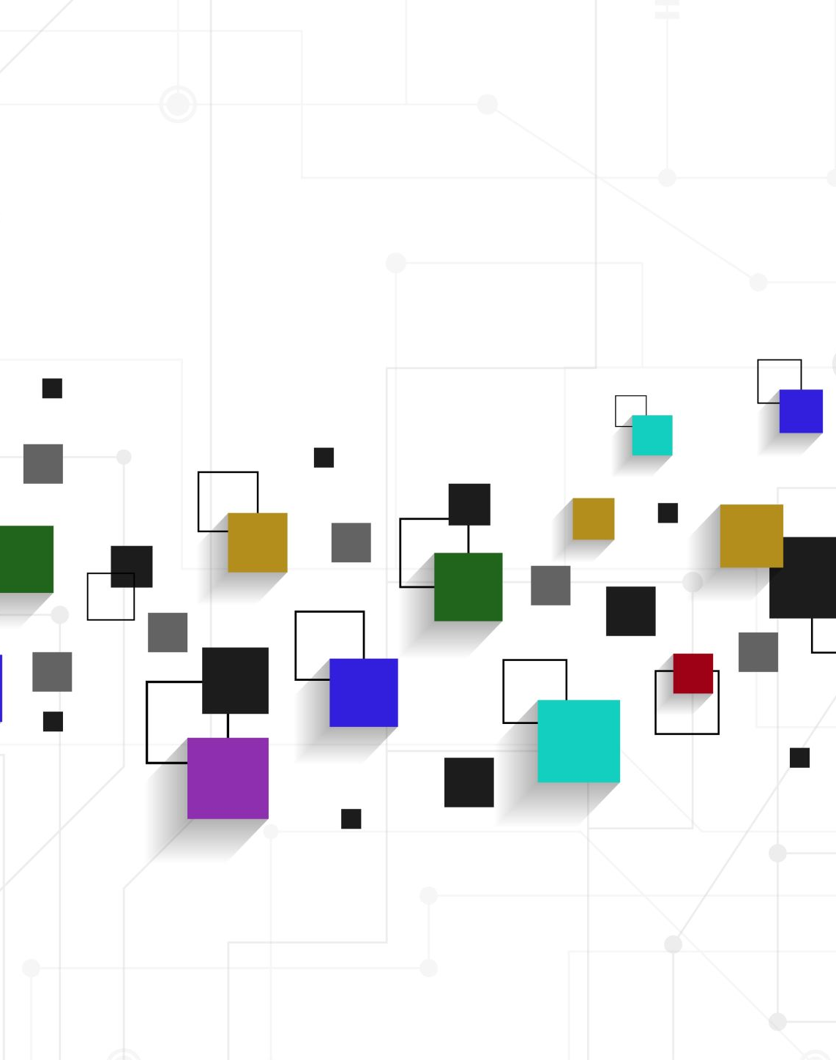
Appraisal
ATTITUDE -
Affect

Slide 2
Appraisal theory
allows us to understand more complex ways in which we express our personal views and react to the views of others (White 2013)
has three resources in language: attitude, graduation and engagement
gives us the language to consider and answer questions about the intention of the writer/speaker

Slide 3
Affect
language of Affect is used to express feelings (Peel, 2014)
is concerned with positive and negative feelings such as un/happiness, in/security, dis/satisfaction etc (HK Polyu n.d.)
is rare in academic writing as it is often with support or evidence (HK Polyu n.d.), but
may be found in eg ethnographic studies or other case studies (HK Polyu n.d.)

Slide 4
Affect may be indicated through:
verbs of emotion (eg to love/hate, to frighten/to reassure) - Your offer pleases me.
adverbs (eg happily/sadly, to interest/to bore, to enrage/to placate) - Sadly the government has decided to abandon its commitment to the comprehensive school system.
adjective of emotion (eg worried/confident, keen/uninterested, angry/pleased) - She’s proud of her achievements.
through nominalisation (eg joy/despair, confidence/insecurity) - His fear was obvious to all.

Slide 5
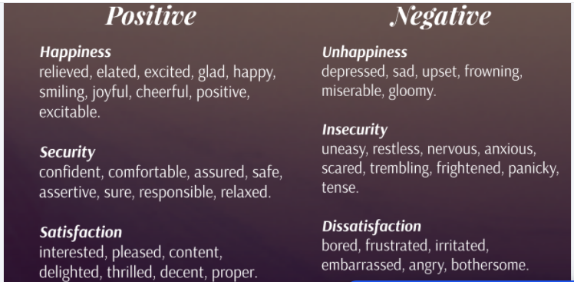
Peel 2014

Slide 6
Affect in academic writing - examples
... as functional discourse can be achieved without the interlocutors being secure in their use of the language.
Item: secure
Appraised: interlocutors
positive affect
Burns (2001) makes the point that students’ sense of security ‘evaporates’ when confronted by authentic discourse exchanges.
Item: evaporates
Appraised: students
negative affect
HK Polyu n.d.

Slide 7
References
Hong Kong Polytechnic University n.d., ‘Attitude’, viewed 27 July 2021, www.engl.polyu.edu.hk/academic_writing/attitude.html.
McGuire, R 2008, ‘Grammar at the chalkface: an introduction to the grammar of Appraisal and its application in a Year 9 classroom’ mETAphor, Issue 1, 2008 pp 42-57
Peel, R 2014, ‘Affect and Judgement (evaluative language)’, viewed 27 July 2021, <Affect and Judgement (evaluative language) by Rosie Peel on Prezi Next.
White, PRR 2013, ‘Systemic Functional Grammar: Appraisal’, An Introduction to Appraisal, ASLA
White, PRR 2015, ‘1. Affect’, viewed 2 August 2021, https://www.grmmatics.com/appraisal/appraisalguide/unframed/stage1-attitude-affect.htm.

