Slide 1
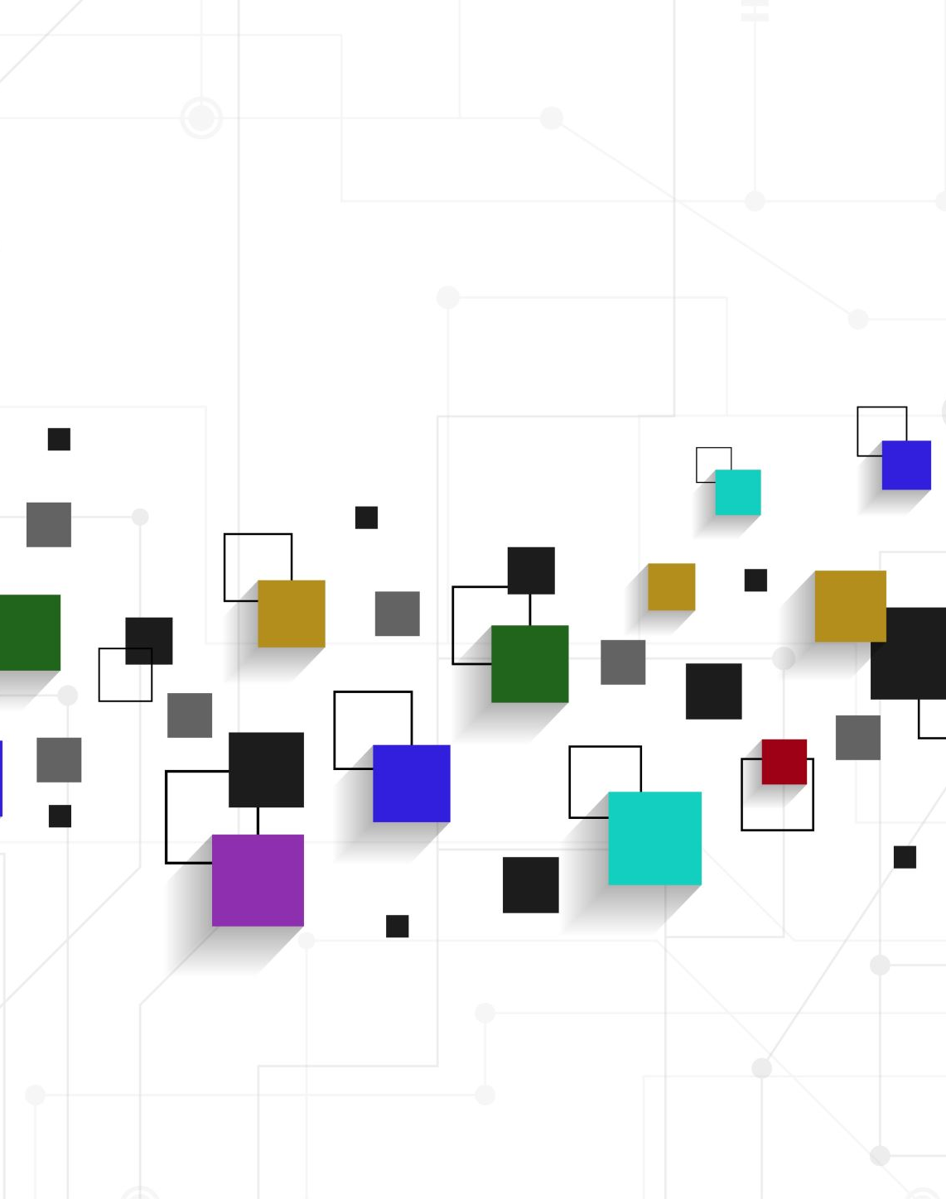
Appraisal
ATTITUDE -
Judgement

Slide 2
Appraisal theory
allows us to understand more complex ways in which we express our personal views and react to the views of others (White 2013)
has three resources in language: attitude, graduation and engagement
gives us the language to consider and answer the following:

Slide 3
What cultural practices appear in and have given rise to the text?
Do these work together or in opposition in setting up particular readings?
Whose and what points of view are being represented?
What has been omitted?
Whose interests are being served by the text?
Are you inclined to accept / resist the points of view in this text?
Who might be an ideal reader of this text?
Who might challenge the viewpoints being expressed? (McGuire 2008)

Slide 4
Judgement
is culturally bound
language of Judgement is used to make positive or negative assessments
can be used to assess the personality, actions or words of a character, and
may be expressed directly or indirectly in words or phrases (Peel 2014)
can generally be divided into judgement of esteem and judgement of sanction

Slide 5
Judgement
esteem
sanction
admiration and criticism
how ab/normal a person is
how in/capable a person is
how un/reliable a person is
praise and condemnation
how a person should behave (eg honesty or morality)
(HK, Polyu n.d.)

Slide 6
 | Positive | Negative
Is the person special? | lucky, cool, interesting, amazing | odd, weird, uninteresting, erratic, clumsy, awkward
Is the person capable? | skilful, strong, fit, clever, smart, fast-thinking | weak, silly, unsuccessful, unintelligent, dim-witted
Is the person dependable? | brave, tireless, reliable, loyal | cowardly, unreliable, timid
Is the person honest? | truthful, credible, honest, direct, good | dishonest, lying, sneaky, untrustworthy
Is the person good? | good, kind, fair, caring, respectful, respectable | bad, evil, arrogant, mean, selfish
(Peel 2014)

Slide 7
References
Hong Kong Polytechnic University n.d., ‘Attitude’, viewed 27 July 2021, www.engl.polyu.edu.hk/academic_writing/attitude.html.
McGuire, R 2008, ‘Grammar at the chalkface: an introduction to the grammar of Appraisal and its application in a Year 9 classroom’ mETAphor, Issue 1, 2008 pp 42-57
Peel, R 2014, ‘Affect and Judgement (evaluative language)’, viewed 27 July 2021, Affect and Judgement (evaluative language) by Rosie Peel on Prezi Next.
White, PRR 2013, ‘Systemic Functional Grammar: Appraisal’, An Introduction to Appraisal, ASLA.

